Slide 1
Honey, I Shrunk ‘ConfigureServices()’
Joel Hammond-Turner
@rammesses

Slide 2
The problem with IoC / Dependency Injection
Convention-based configuration
Unexpected imports
Imperative configuration
”God Objects” a.k.a. Composition Roots
Microsoft DI ‘ConfigureServices()’
– shouldn’t be a ”God Object”
– but usually is

Slide 3
Reference Sample
using Ardalis.ListStartupServices;
using Microsoft.AspNetCore.Builder;
using Microsoft.AspNetCore.Diagnostics.HealthChecks;
using Microsoft.AspNetCore.Hosting;
using Microsoft.AspNetCore.Http;
using Microsoft.AspNetCore.Identity;
using Microsoft.AspNetCore.Identity.UI;
using Microsoft.AspNetCore.Mvc;
using Microsoft.AspNetCore.Mvc.ApplicationModels;
using Microsoft.AspNetCore.Routing;
using Microsoft.EntityFrameworkCore;
using Microsoft.eShopWeb.ApplicationCore.Interfaces;
using Microsoft.eShopWeb.ApplicationCore.Services;
using Microsoft.eShopWeb.Infrastructure.Data;
using Microsoft.eShopWeb.Infrastructure.Identity;
using Microsoft.eShopWeb.Infrastructure.Logging;
using Microsoft.eShopWeb.Infrastructure.Services;
using Microsoft.eShopWeb.Web.HealthChecks;
using Microsoft.eShopWeb.Web.Interfaces;
using Microsoft.eShopWeb.Web.Services;
using Microsoft.Extensions.Configuration;
using Microsoft.Extensions.DependencyInjection;
using Microsoft.Extensions.Diagnostics.HealthChecks;
using Newtonsoft.Json;
using Swashbuckle.AspNetCore.Swagger;
using System;
using System.Collections.Generic;
using System.Linq;
using System.Net.Mime;
namespace Microsoft.eShopWeb.Web
{
public class Startup
{
private IServiceCollection _services;
public Startup(IConfiguration configuration)
{
Configuration = configuration;
}
public IConfiguration Configuration { get; }
public void ConfigureDevelopmentServices(IServiceCollection services)
{
// use in-memory database
ConfigureInMemoryDatabases(services);
// use real database
// ConfigureProductionServices(services);
}
private void ConfigureInMemoryDatabases(IServiceCollection services)
{
// use in-memory database
services.AddDbContext<CatalogContext>(c =>
c.UseInMemoryDatabase("Catalog"));
// Add Identity DbContext
services.AddDbContext<AppIdentityDbContext>(options =>
options.UseInMemoryDatabase("Identity"));
ConfigureServices(services);
}
public void ConfigureProductionServices(IServiceCollection services)
{
// use real database
// Requires LocalDB which can be installed with SQL Server Express 2016
// https://www.microsoft.com/en-us/download/details.aspx?id=54284
services.AddDbContext<CatalogContext>(c =>
c.UseSqlServer(Configuration.GetConnectionString("CatalogConnection")));
// Add Identity DbContext
services.AddDbContext<AppIdentityDbContext>(options =>
options.UseSqlServer(Configuration.GetConnectionString("IdentityConnection")));
ConfigureServices(services);
}
// This method gets called by the runtime. Use this method to add services to the container.
public void ConfigureServices(IServiceCollection services)
{
ConfigureCookieSettings(services);
CreateIdentityIfNotCreated(services);
services.AddScoped(typeof(IAsyncRepository<>), typeof(EfRepository<>));
services.AddScoped<ICatalogViewModelService, CachedCatalogViewModelService>();
services.AddScoped<IBasketService, BasketService>();
services.AddScoped<IBasketViewModelService, BasketViewModelService>();
services.AddScoped<IOrderService, OrderService>();
services.AddScoped<IOrderRepository, OrderRepository>();
services.AddScoped<CatalogViewModelService>();
services.Configure<CatalogSettings>(Configuration);
services.AddSingleton<IUriComposer>(new UriComposer(Configuration.Get<CatalogSettings>()));
services.AddScoped(typeof(IAppLogger<>), typeof(LoggerAdapter<>));
services.AddTransient<IEmailSender, EmailSender>();
// Add memory cache services
services.AddMemoryCache();
services.AddRouting(options =>
{
// Replace the type and the name used to refer to it with your own
// IOutboundParameterTransformer implementation
options.ConstraintMap["slugify"] = typeof(SlugifyParameterTransformer);
});
services.AddMvc(options =>
{
options.Conventions.Add(new RouteTokenTransformerConvention(
new SlugifyParameterTransformer()));
}
)
.AddRazorPagesOptions(options =>
{
options.Conventions.AuthorizePage("/Basket/Checkout");
options.AllowAreas = true;
})
.SetCompatibilityVersion(CompatibilityVersion.Version_2_2);
services.AddHttpContextAccessor();
services.AddSwaggerGen(c =>
{
c.SwaggerDoc("v1", new Info { Title = "My API", Version = "v1" });
});
services.AddHealthChecks()
.AddCheck<HomePageHealthCheck>("home_page_health_check")
.AddCheck<ApiHealthCheck>("api_health_check");
services.Configure<ServiceConfig>(config =>
{
config.Services = new List<ServiceDescriptor>(services);
config.Path = "/allservices";
});
_services = services; // used to debug registered services
}
private static void CreateIdentityIfNotCreated(IServiceCollection services)
{
var sp = services.BuildServiceProvider();
using (var scope = sp.CreateScope())
{
var existingUserManager = scope.ServiceProvider
.GetService<UserManager<ApplicationUser>>();
if(existingUserManager == null)
{
services.AddIdentity<ApplicationUser, IdentityRole>()
.AddDefaultUI(UIFramework.Bootstrap4)
.AddEntityFrameworkStores<AppIdentityDbContext>()
.AddDefaultTokenProviders();
}
}
}
private static void ConfigureCookieSettings(IServiceCollection services)
{
services.Configure<CookiePolicyOptions>(options =>
{
// This lambda determines whether user consent for non-essential cookies is needed for a given request.
options.CheckConsentNeeded = context => true;
options.MinimumSameSitePolicy = SameSiteMode.None;
});
services.ConfigureApplicationCookie(options =>
{
options.Cookie.HttpOnly = true;
options.ExpireTimeSpan = TimeSpan.FromHours(1);
options.LoginPath = "/Account/Login";
options.LogoutPath = "/Account/Logout";
options.Cookie = new CookieBuilder
{
IsEssential = true // required for auth to work without explicit user consent; adjust to suit your privacy policy
};
});
}
// This method gets called by the runtime. Use this method to configure the HTTP request pipeline.
public void Configure(IApplicationBuilder app, IHostingEnvironment env)
{
//app.UseDeveloperExceptionPage();
app.UseHealthChecks("/health",
new HealthCheckOptions
{
ResponseWriter = async (context, report) =>
{
var result = JsonConvert.SerializeObject(
new
{
status = report.Status.ToString(),
errors = report.Entries.Select(e => new
{
key = e.Key,
value = Enum.GetName(typeof(HealthStatus), e.Value.Status)
})
});
context.Response.ContentType = MediaTypeNames.Application.Json;
await context.Response.WriteAsync(result);
}
});
if (env.IsDevelopment())
{
app.UseDeveloperExceptionPage();
app.UseShowAllServicesMiddleware();
app.UseDatabaseErrorPage();
}
else
{
app.UseExceptionHandler("/Error");
// The default HSTS value is 30 days. You may want to change this for production scenarios, see https://aka.ms/aspnetcore-hsts.
app.UseHsts();
}
app.UseHttpsRedirection();
app.UseStaticFiles();
app.UseCookiePolicy();
app.UseAuthentication();
// Enable middleware to serve generated Swagger as a JSON endpoint.
app.UseSwagger();
// Enable middleware to serve swagger-ui (HTML, JS, CSS, etc.),
// specifying the Swagger JSON endpoint.
app.UseSwaggerUI(c =>
{
c.SwaggerEndpoint("/swagger/v1/swagger.json", "My API V1");
});
app.UseMvc(routes =>
{
routes.MapRoute(
name: "default",
template: "{controller:slugify=Home}/{action:slugify=Index}/{id?}");
});
}
}
}
eShopOnWeb
https://github.com/dotnet-architecture/eShopOnWeb
‘ConfigureServices()’ in Startup.cs
140 LoC / 183 total LoC
76% of Startup Code

Slide 4
Three Approaches
#1 - Refactor into (internal) methods
#2 - Refactor into (external) ‘AddServices()’ extension methods
#3 - Use Bootstrapper Discovery

Slide 5
Show The Code!
Refactor into methods

Slide 6
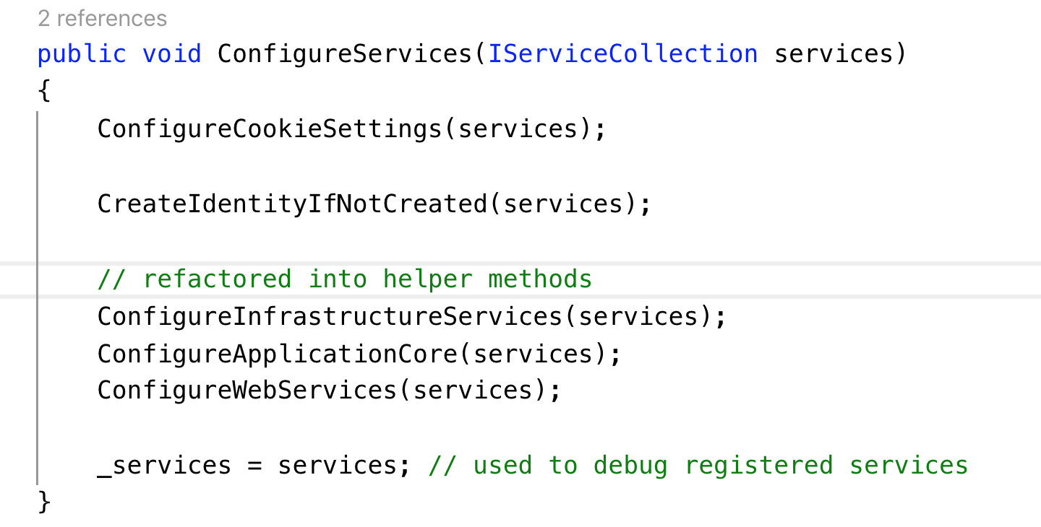
Approach #1 – Refactor into Methods
😢
`ConfigureServices()`
(actually the `Startup` class)
- Still a “God Object”

Slide 7
Show The Code!
Approach #2 – Refactor into ‘AddServices()’ methods

Slide 8
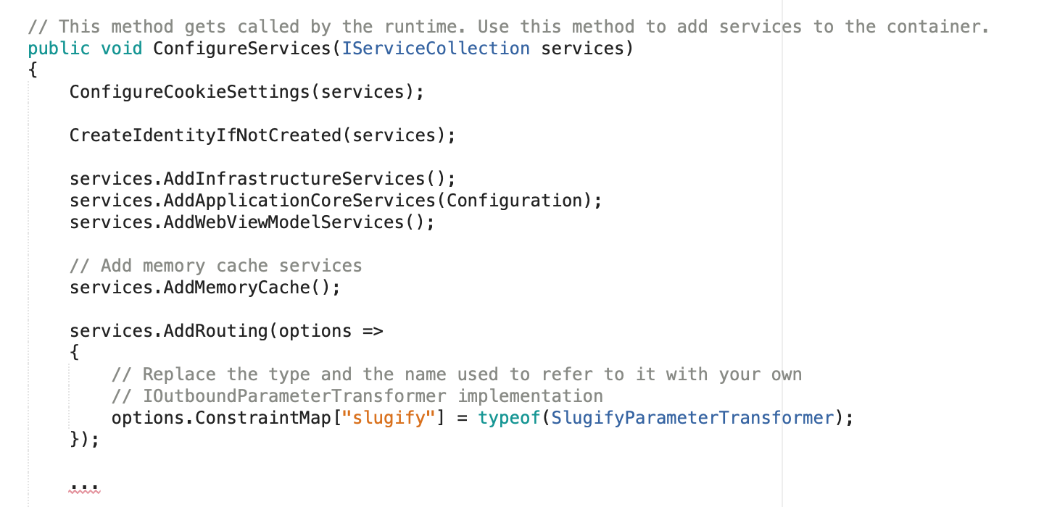
Approach #2 – AddServices() methods
🤔
`ConfigureServices()`
- No ”God Object”
- Still tightly coupled

Slide 9
Show The Code!
Approach #3 – Bootstrapper discovery

Slide 10
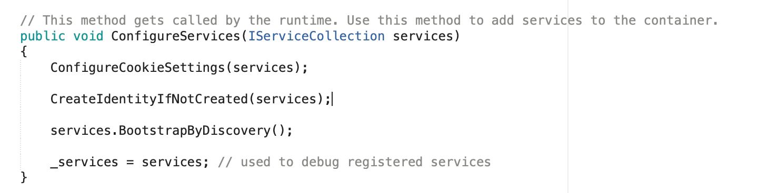
Approach #3 – Bootstrapper Discovery
😍
‘ConfigureServices()’
- NO “God Object”
- Basically a 1-liner

Slide 11
In Summary
DON’T let ‘ConfigureServices()’ become a ‘God Object’
Especially if you’re copying-and-pasting registrations between projects
DO create ‘AddServices()’ methods
Especially for shared code (NuGet packages)
DO put registrations “close” to implementations
Interfaces are most often for testing with a single implementation
Be explicit in your dependency chaining

Slide 12
Honey, I Shrunk `ConfigureServices()`
Joel Hammond-Turner
@rammesses

